Slide 1
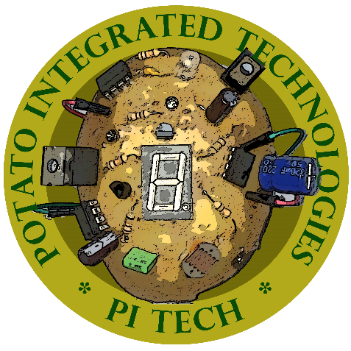
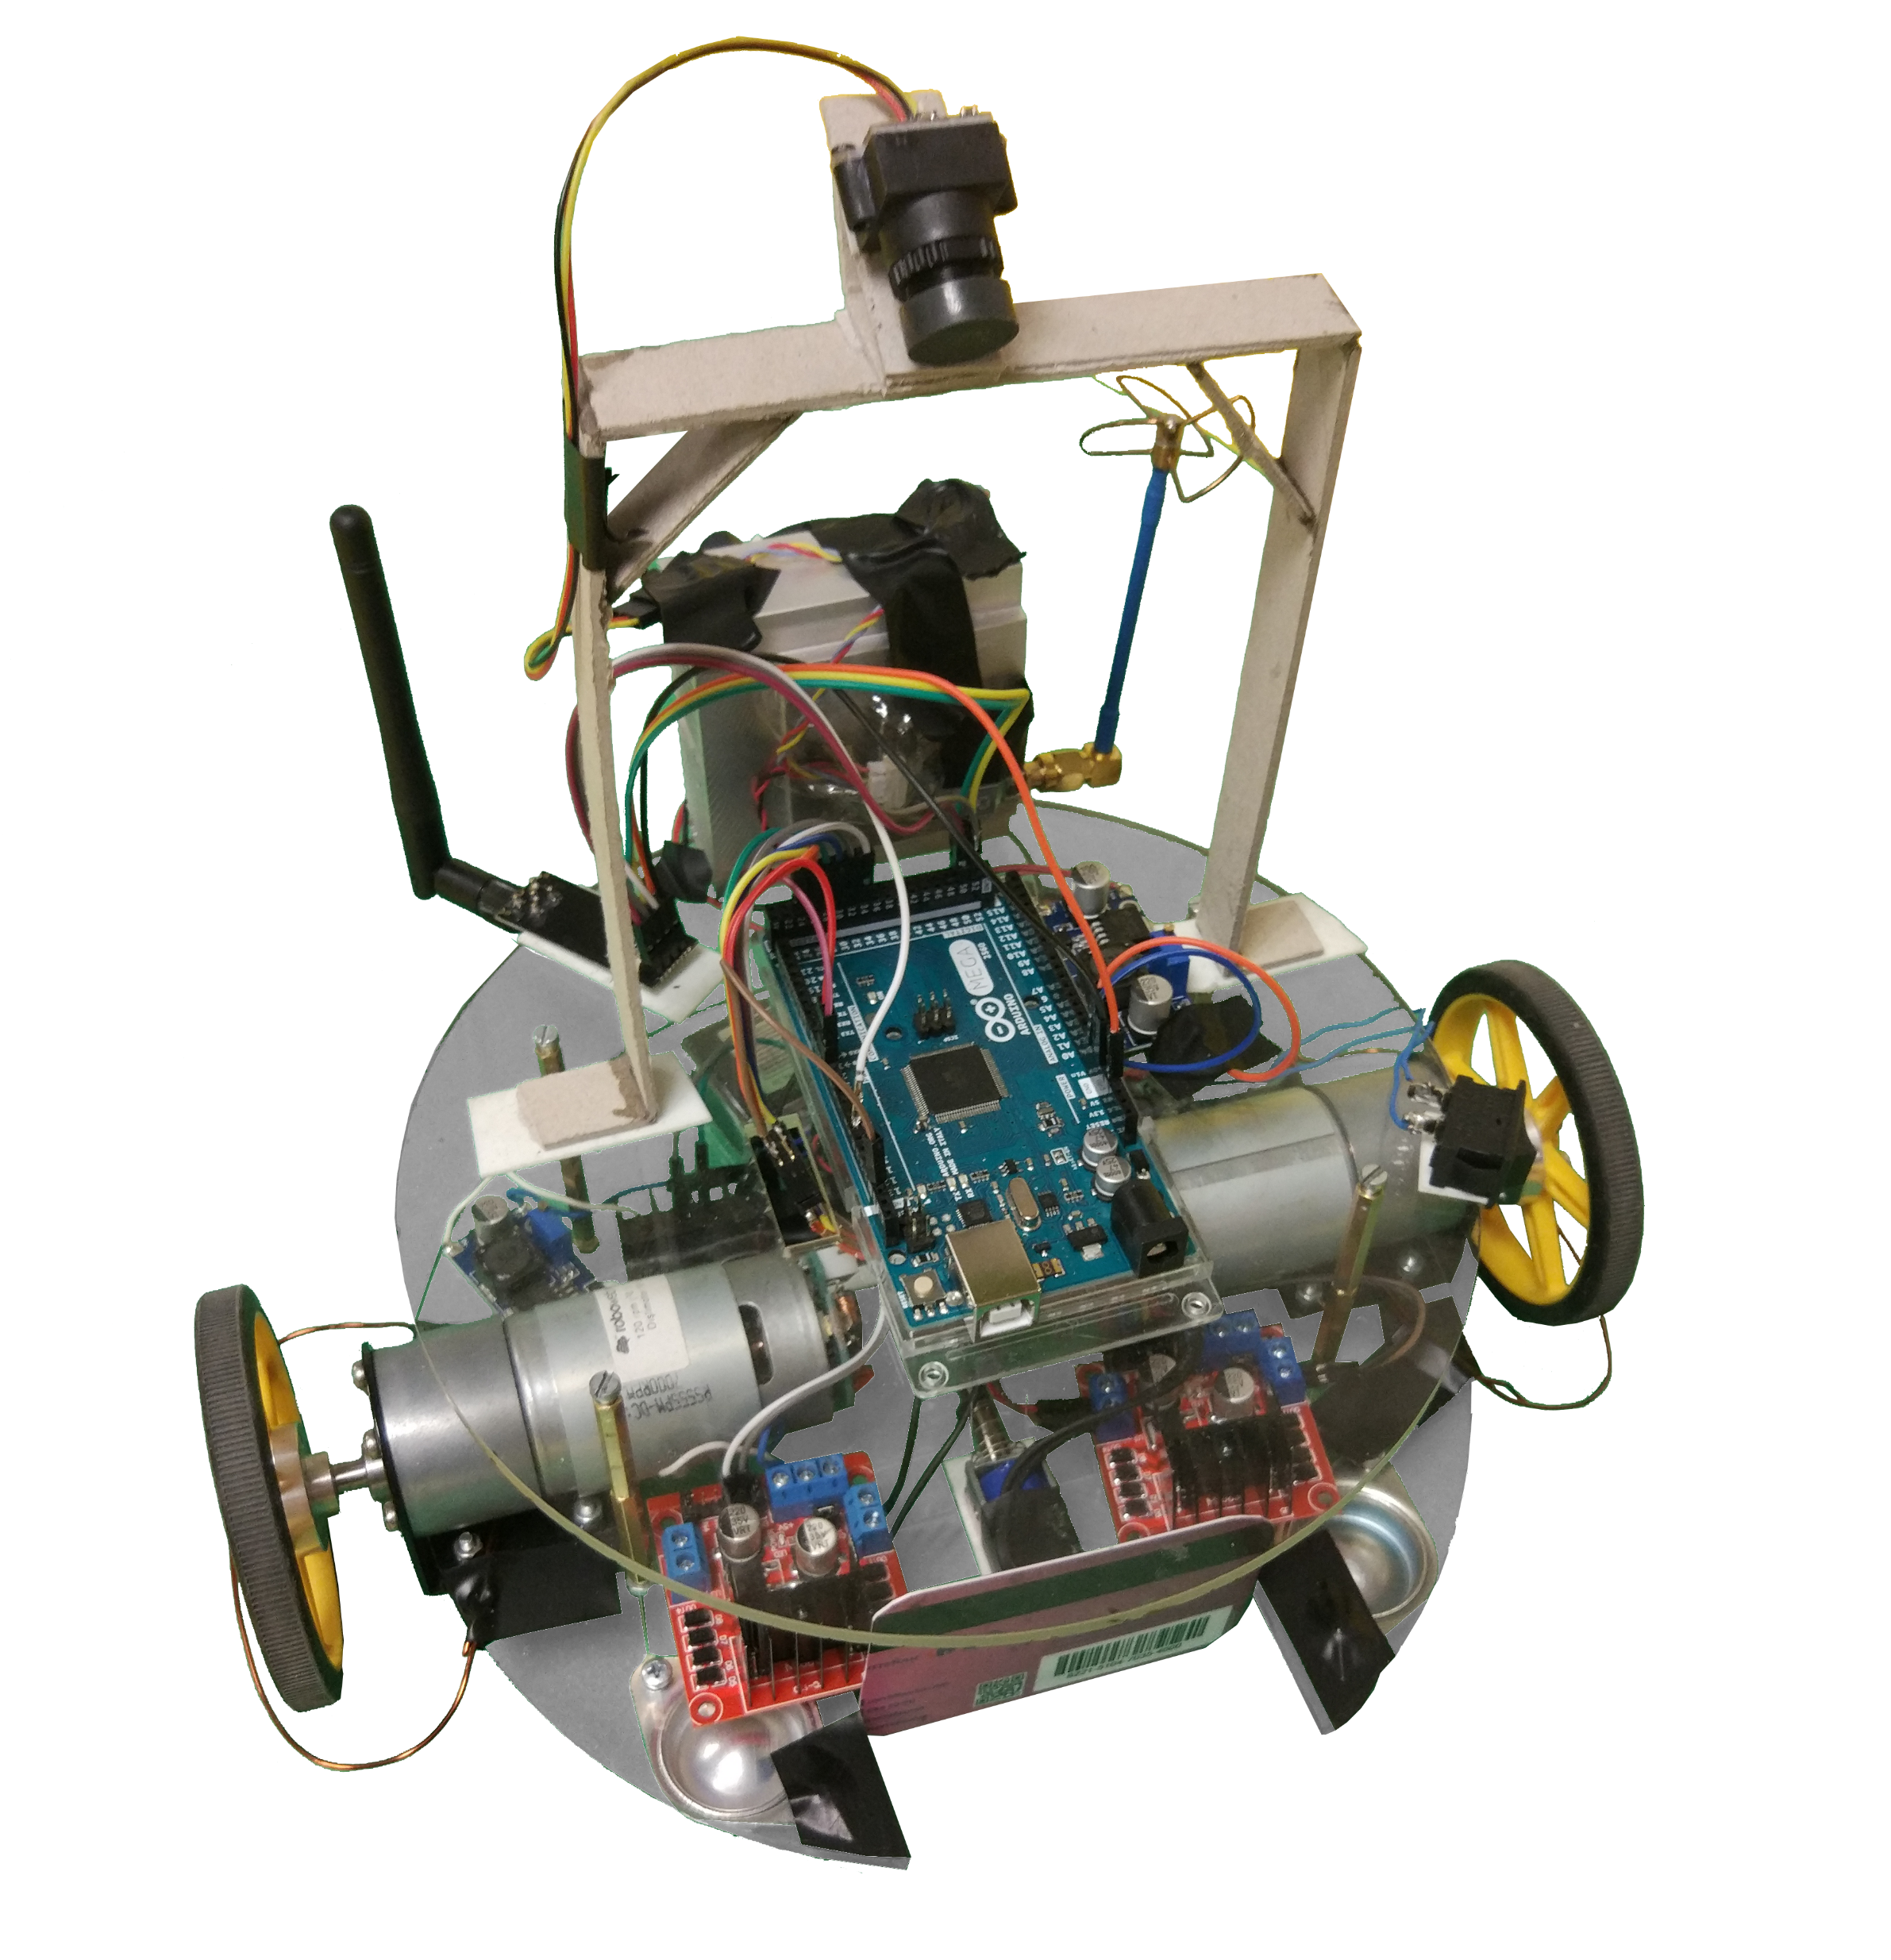
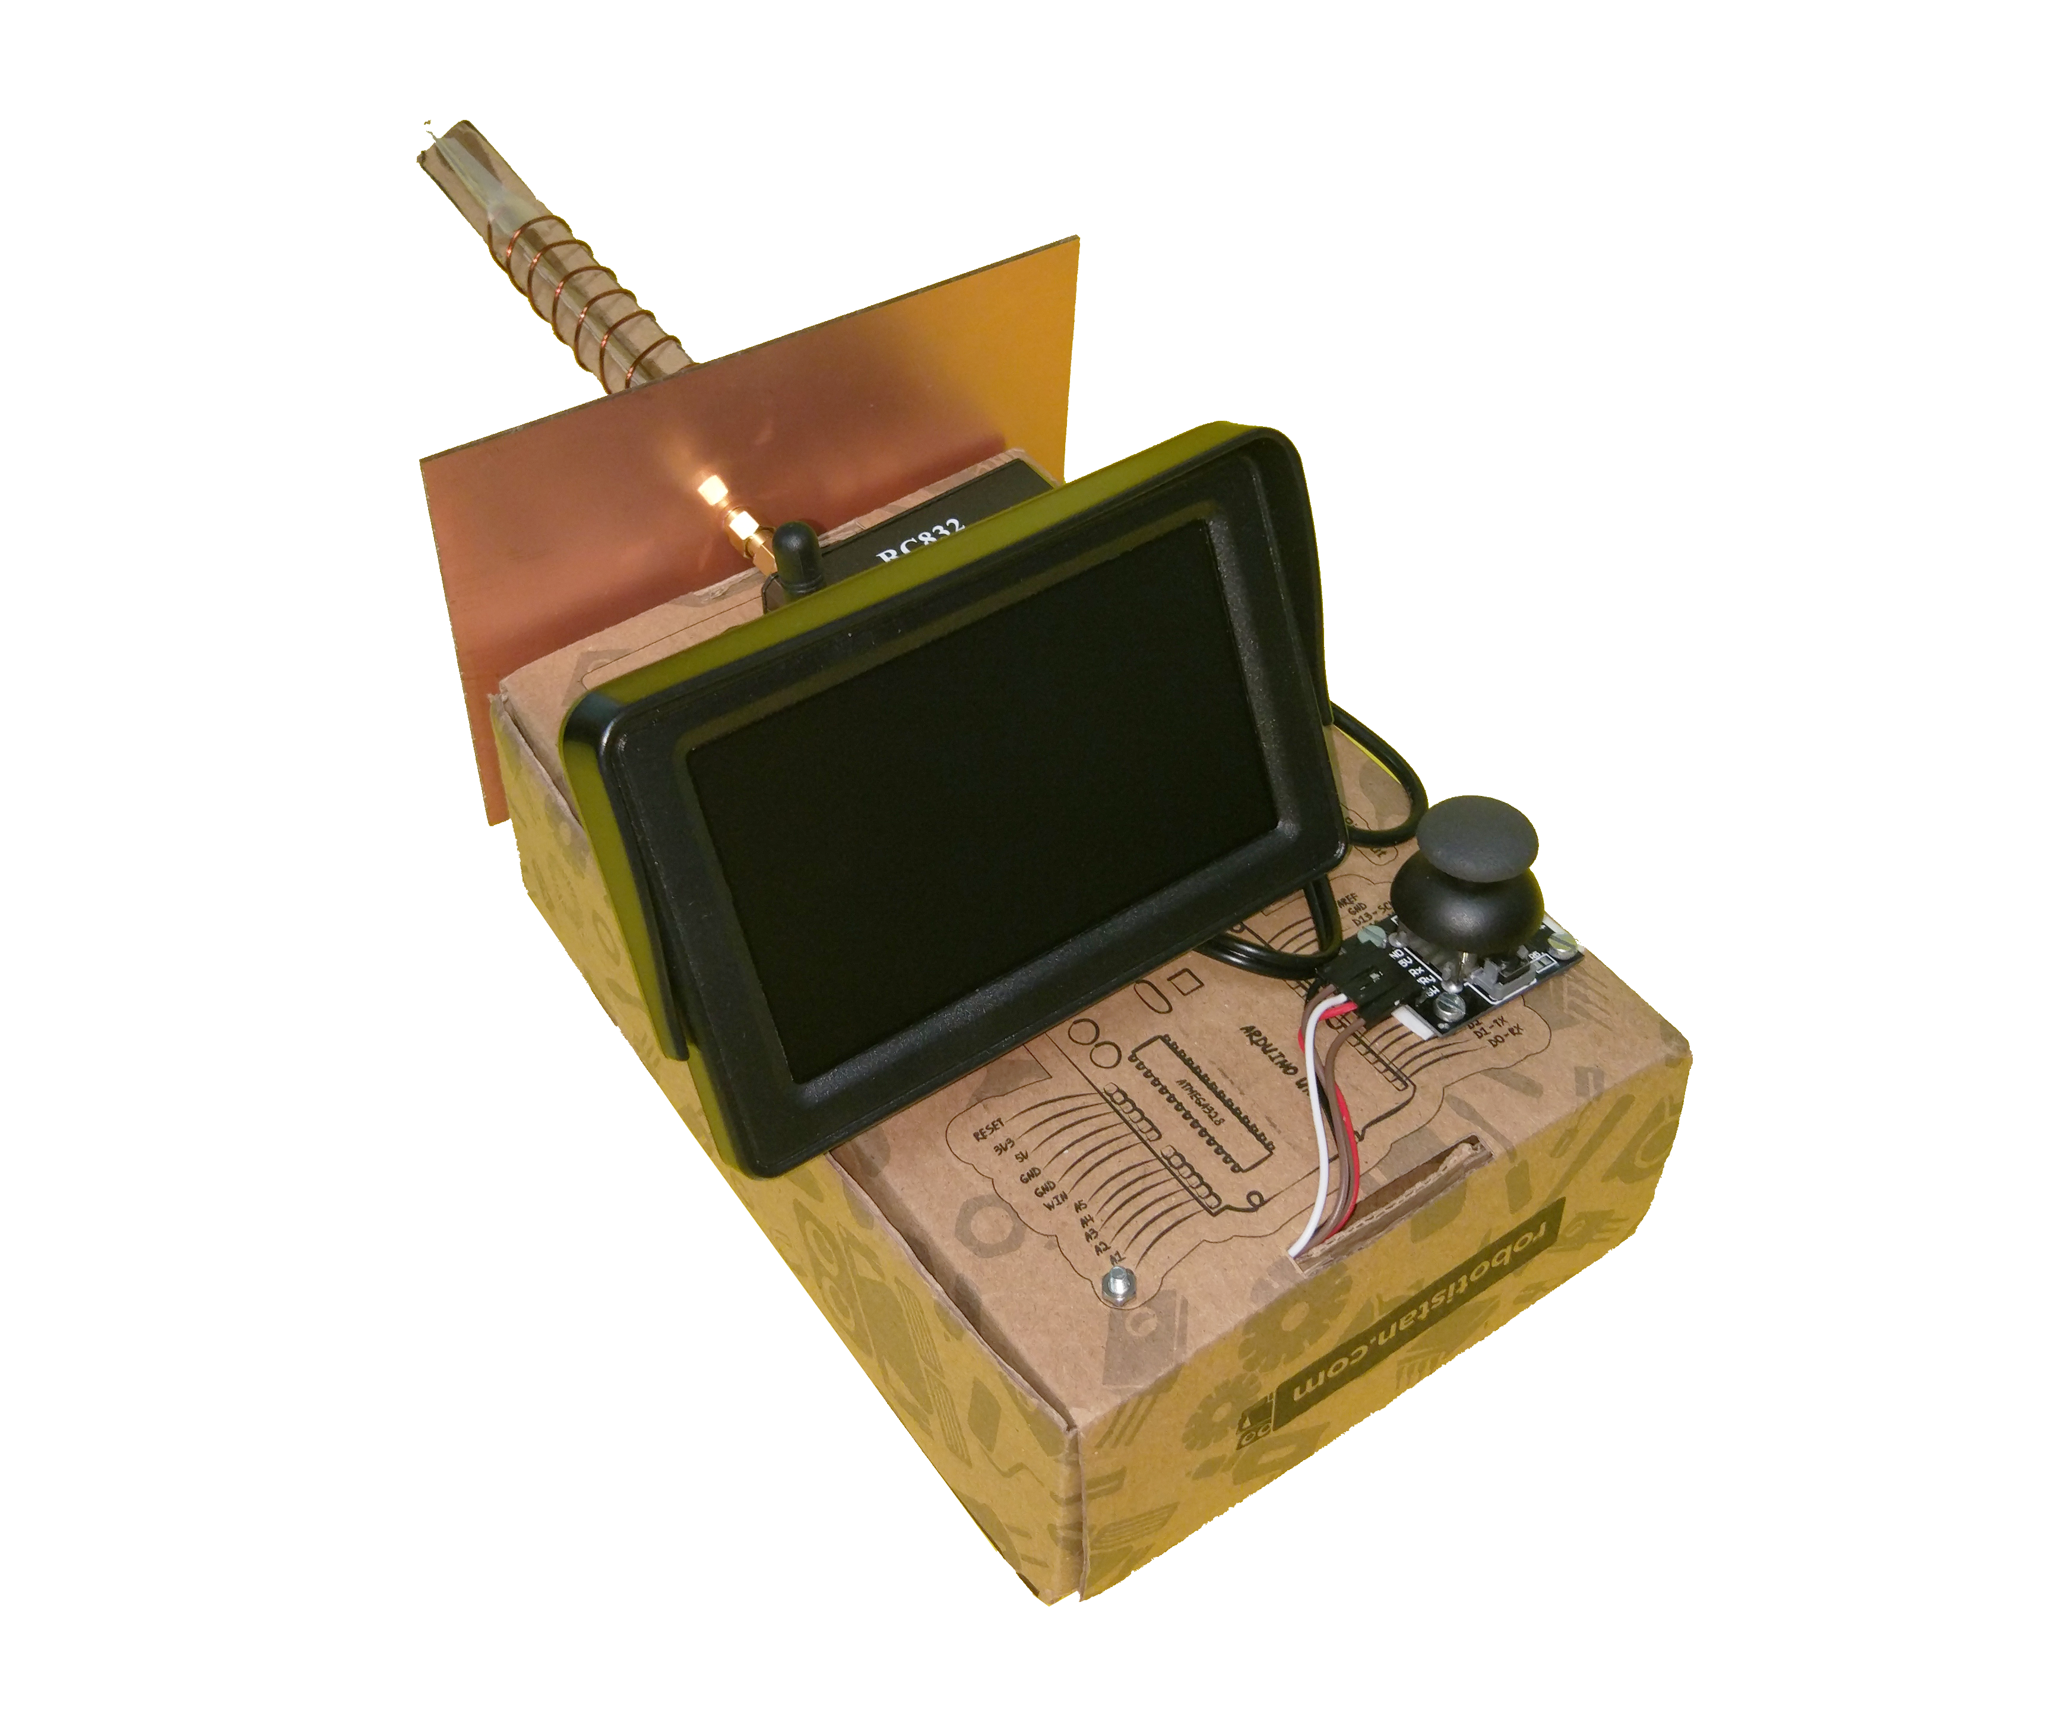
Potato Integrated Technologies
PITECH (Potato Integrated Technologies) was founded in 2018 with five shareholders from different backgrounds. As PITECH engineers our aim is to build a robot that we can control from a distance up to at least 30 meter indoor with a remote controller. This robot tries to score within a playfield in its opponent’s goal and defend its own goal without actually monitoring the play-field with naked eye. It transfers the ball to opponent’s half-field in less than 20 seconds without grasping, scooping or carrying the ball.
SHAREHOLDERS
BUDGET
Fatma Nur Arabacı - CEO
Furkan Bahadır ELİK - CTO
İrem COŞKUN - COO
Berkay GÖKSU - CMO
Aycan BEYENİR - CFO
Materials |  | Cost
DC Motor with Gearbox |  | 2 x $15
L298N Motor Driver |  | 2 x $1.5
Push-Pull Solenoid |  | 1 x $4
Clone Arduino Uno |  | 1 x $4
Clone Arduino Mega |  | 1 x $10
FPV Drone Kit |  | 1 x $35
NRF24L01+PA+LNA SMA |  | 2 x $4
Joystick |  | 1 x $0.50
LCD screen |  | 1 x $30
900 mAh Li-Po Battery |  | 1 x $14
1350 mAh Li-Po Battery |  | 1 x $18
Buck Converter |  | 3 x $1
Plexiglass Chassis |  | 1 x $6
Standard Wheels |  | 2 x $2
Ball Wheel |  | 3 x $1
Cables & Connectors |  | $6
Structural connections |  | $3
Dummy Robot |  | 1 x $2
Balls |  | 2 x $0.25
Play Field Walls |  | 3 x $1
Total: |  | $189
DELIVERABLES
Potato Robot Controller Unit 2 Li-Po Battery 6 Game Field Walls 2 Balls A Dummy Robot User Manual 2-year Warranty Software Pack
OUTSTANDING FEATURES
User friendly control module
Fast-learning curve for the user
Wide field of view
TECHNICAL SPECIFICATIONS
Telecontroller Side
Physical specifications
Size (width x height x length) | 15 x 15 x 37 cm
Weight | 560 gr
Power Specifications
Idle Power | 8.03 W
Max Power | 8.03 W
Operation Time | 36 min
Operational Specifications
Screen Resolution | 800*480
Command Resolution | 8 bit
Robot Side
Physical specifications
Height | 27 cm
Diameter | 28 cm
Weight | 1710 gr
Power Specifications
Idle Power | 5.63 W
Max Power | 18.83 W
Operation Time | 38 min
Operational Specifications
Maximum Forward Speed | 0.45 m/sec
Maximum Rotational Speed | 2.3 rad/sec
Method of Solution
Command Interface : Joystick Command Transfer : 2.4 GHz NRF Communication Video Transfer : 5.8 GHz FPV Communication Shooting : Push - Pull Solenoid Motion : Brushed DC Motor with Gear Box
Test Results
Customer & Engineering Requirements
$200 budget 30+ meters indoor range Robot can hit, push or otherwise drive the ball but not grasp, scoop or otherwise carry it. Robot should transfer the ball to opponent’s half-field in less than 20 seconds.
Special Thanks to our Supervisor Arzu Tuncay KOÇ

